Slide 1
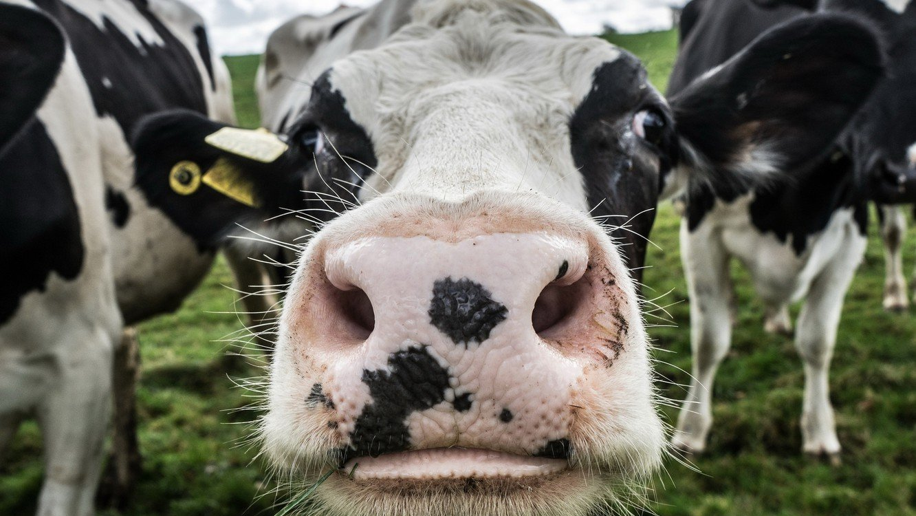
COWS ARE COOL!
This Photo by Unknown Author is licensed under CC BY-NC

Slide 2
Directions: follow along with your connect-the-dots worksheet
Pay attention to the numbers
Learn cool things about cows
Become an amazing veterinarian!

Slide 3
We think cows are the _____ animals on the planet!
#1

Slide 4
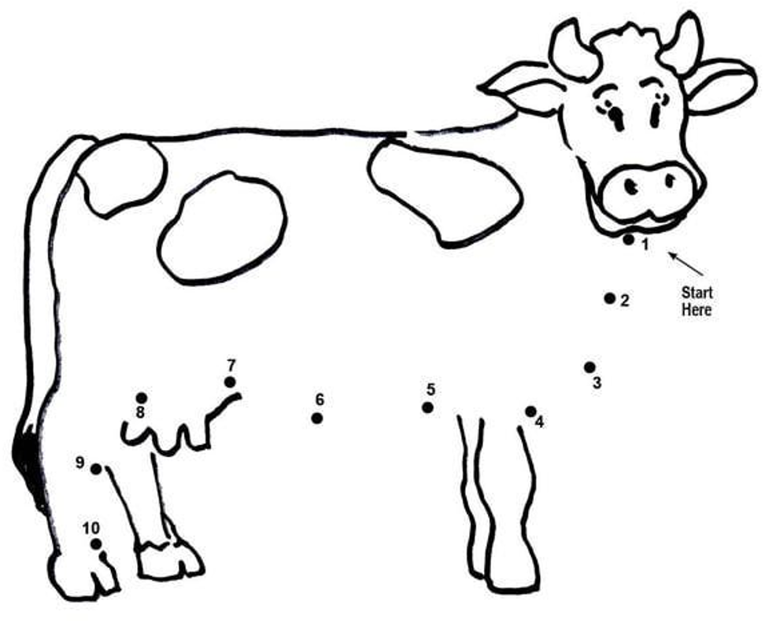
MARK THE #1 ON YOUR SHEET

Slide 5
How many ears do cows have?
2

Slide 6
Draw a line To #2 ON YOUR SHEET

Slide 7
How many times a day are cows milked?
3

Slide 8
Draw a line to #3 ON YOUR SHEET

Slide 9
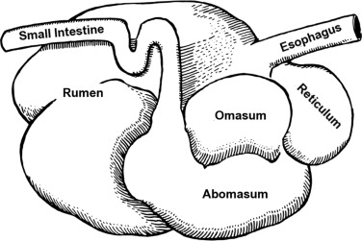
How many stomachs do cows have?
4

Slide 10
Draw a line to #4 ON YOUR SHEET

Slide 11
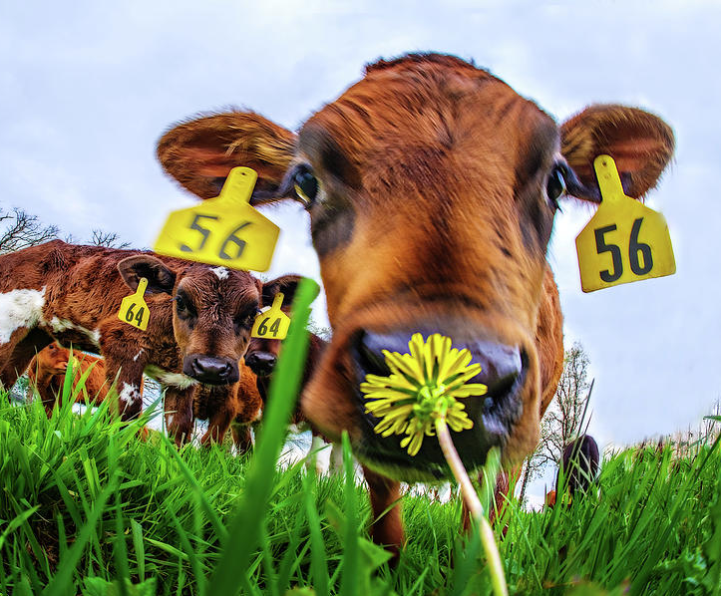
Cows have a great sense of smell! They can smell up to how many miles away?
5

Slide 12
Draw a line to #5 ON YOUR SHEET

Slide 13
Cows have ______ degree vision!
360

Slide 14
Draw a line to #6 ON YOUR SHEET

Slide 15
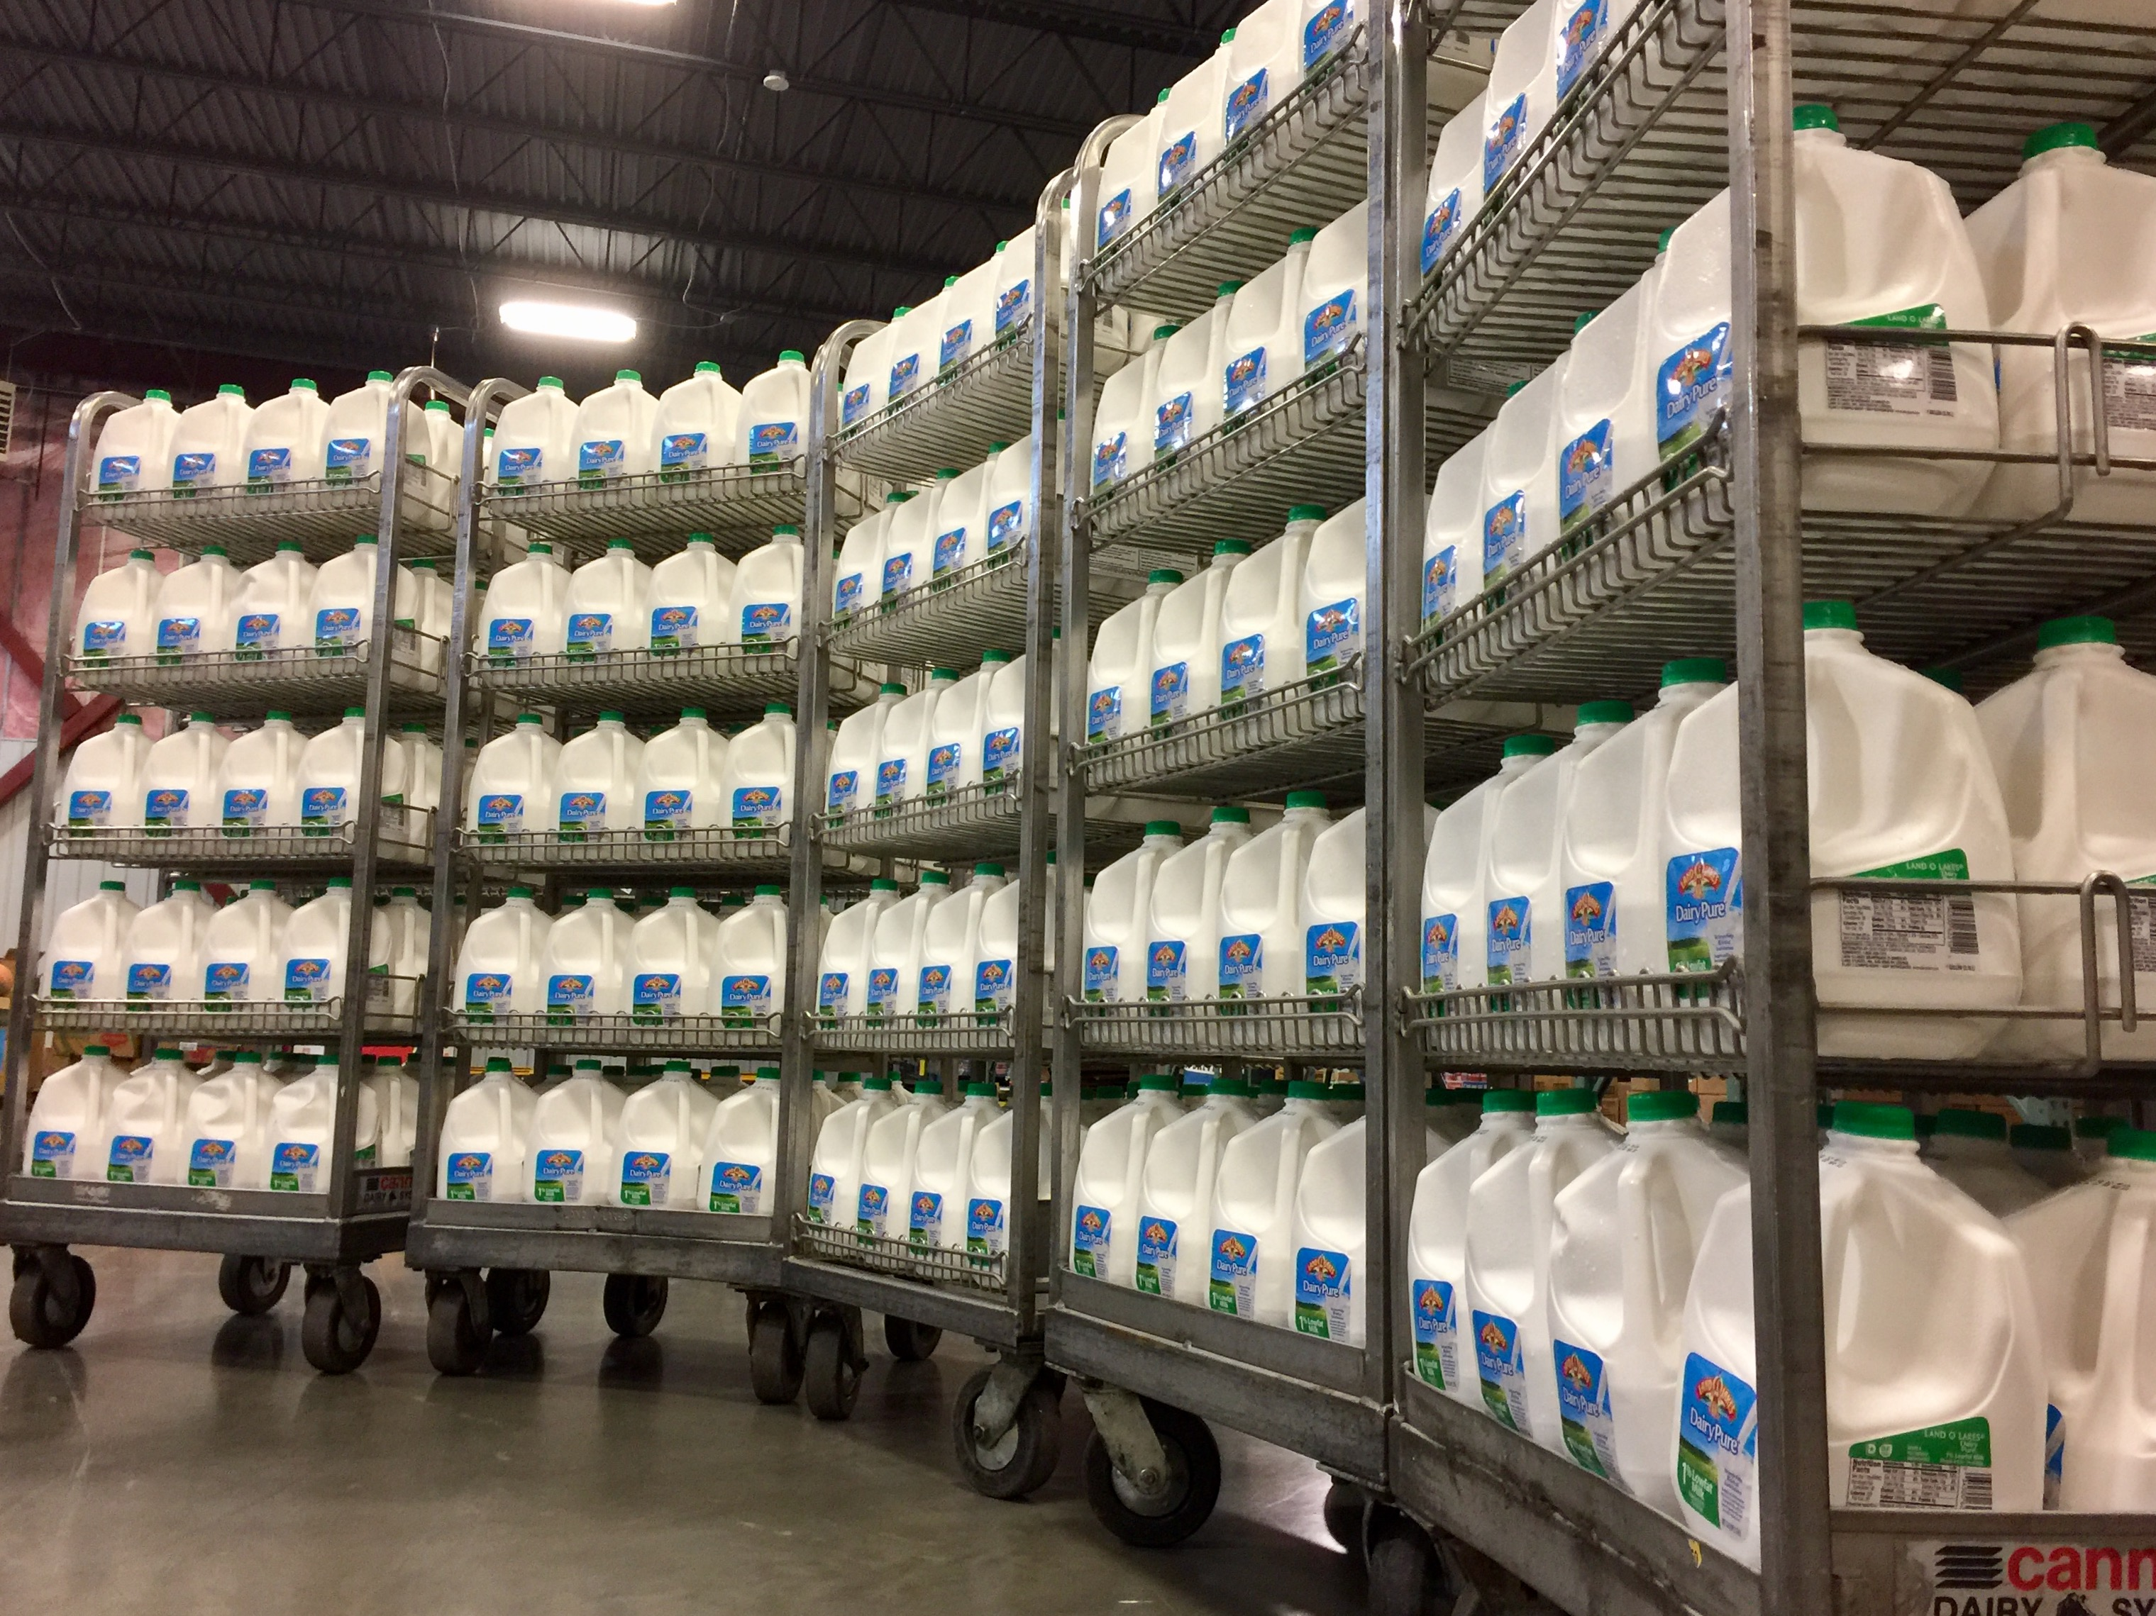
How many gallons of milk can a cow make In one day?
7

Slide 16
Draw a line to #7 ON YOUR SHEET

Slide 17
How many toes total do cows have?
8

Slide 18
Draw a line to #8 ON YOUR SHEET

Slide 19
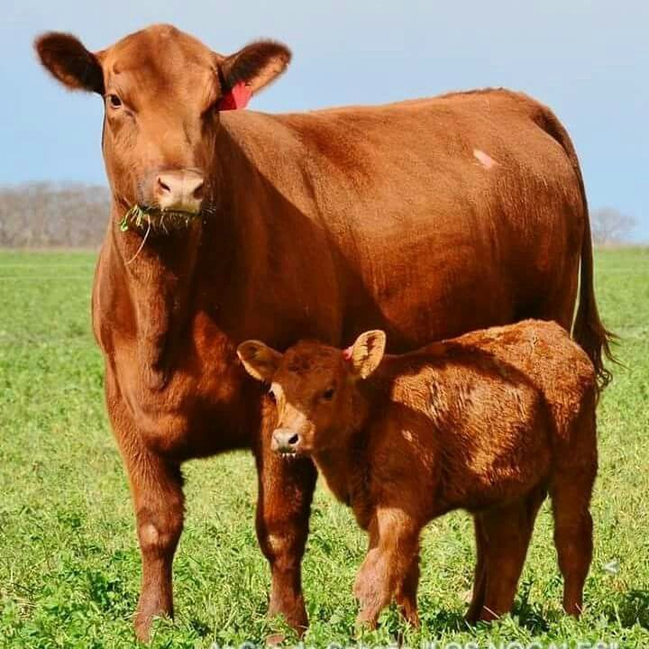
How many months are cows pregnant for?
9

Slide 20
Draw a line to #9 ON YOUR SHEET

Slide 21
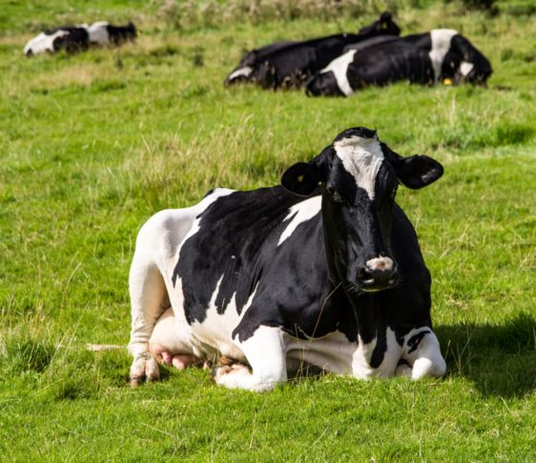
How many hours a day do cows spend lying down?
10

Slide 22
Draw a line to #10 ON YOUR SHEET

Slide 23
THAT’S ALL FOLKS

